Slide 1

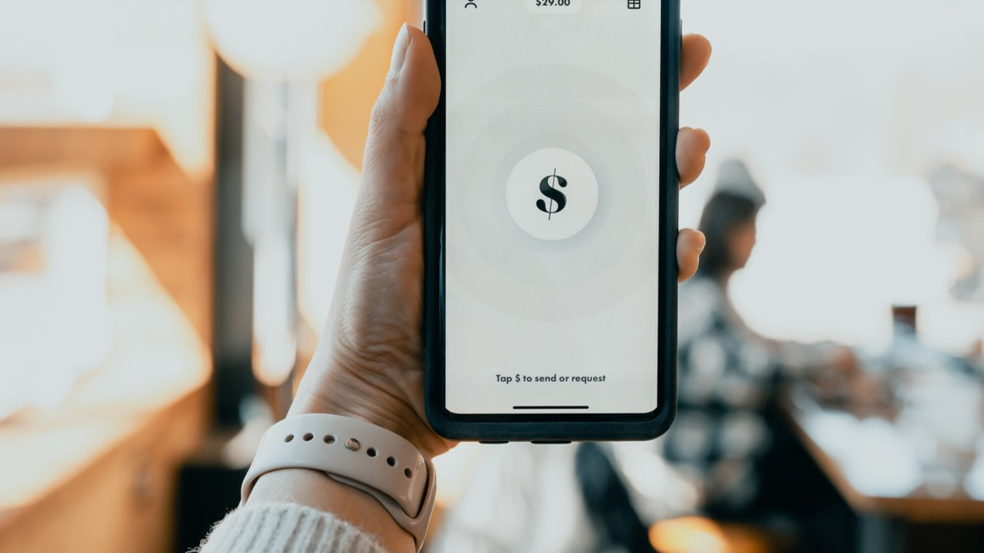
Chitti_lokha
Aryan Gaurav
Nizdain Ahmed
Wasif Alam
Kumar Kshitij
Kavisha Agrawal

Slide 2
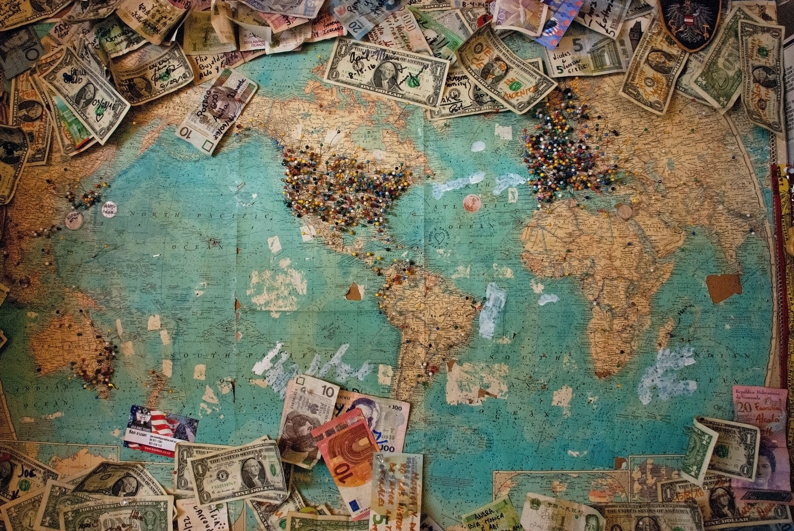
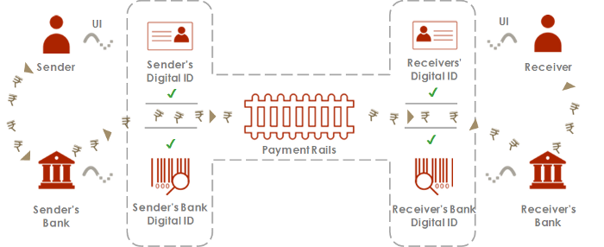
How UPI works??

Slide 3
Problem Addressed
Poor internet connectivity is the major trouble being faced by people trying to adopt digital payments.
Online payments seem to be clustered around regions with better internet connectivity.
Most of the existing solutions rely on assumption of having a good internet connectivity with at least one of the customer or merchant.
But what if, a necessary payment is to be made and internet / mobile operator services are not available at all?

Slide 4

HOW OUR SOLUTION WORKS? ?

Slide 5
STEP 1
ESTABLISHING THE LOCAL CONNECTION

Slide 6
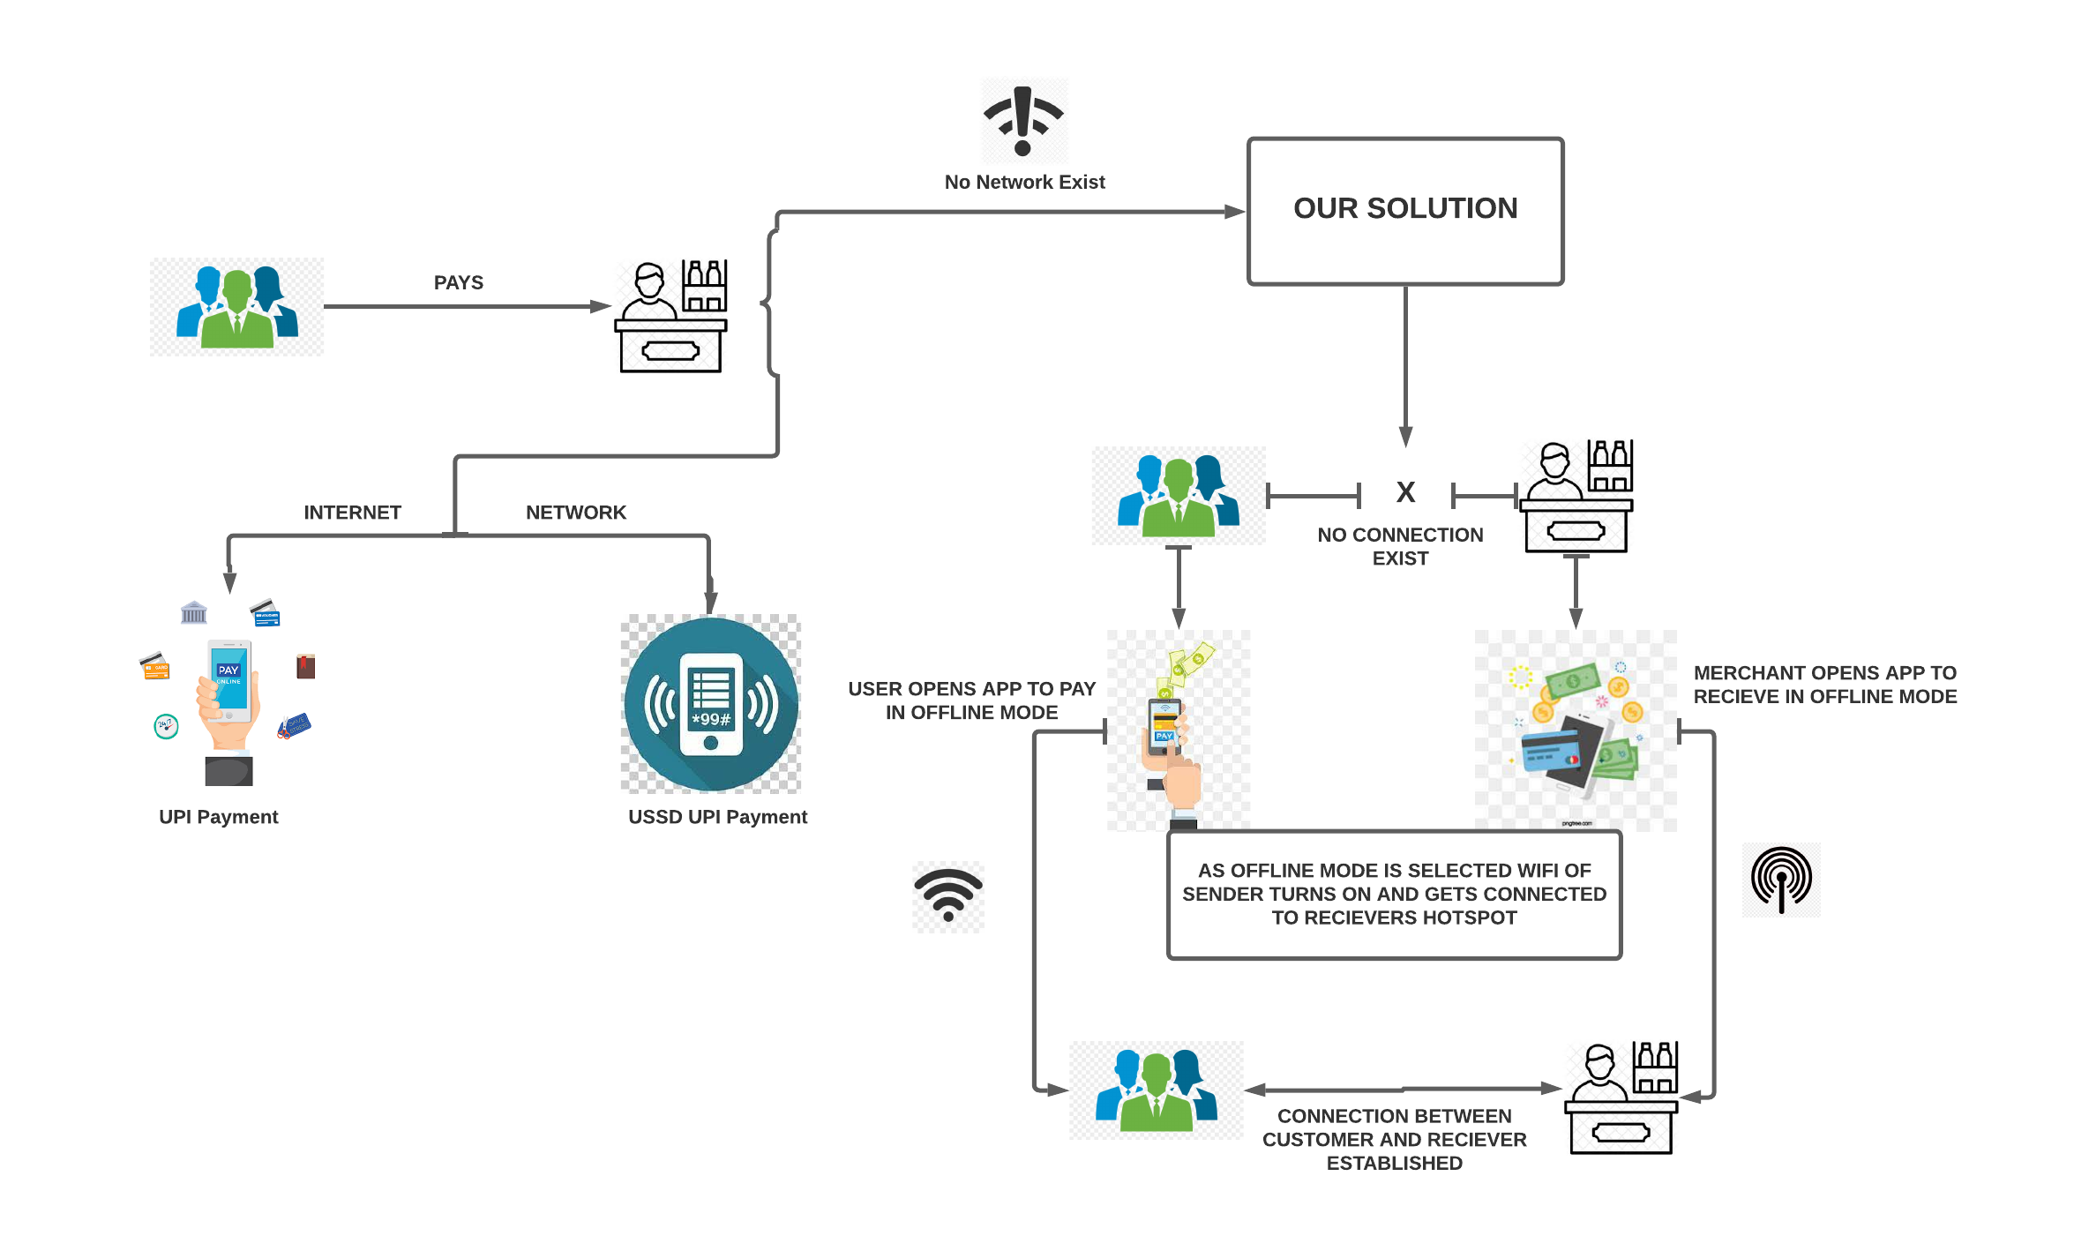

Slide 7
STEP 2
ONCE THE CONNECTION IS ESTABLISHED, HOW THE APPLICATION WORKS?

Slide 8

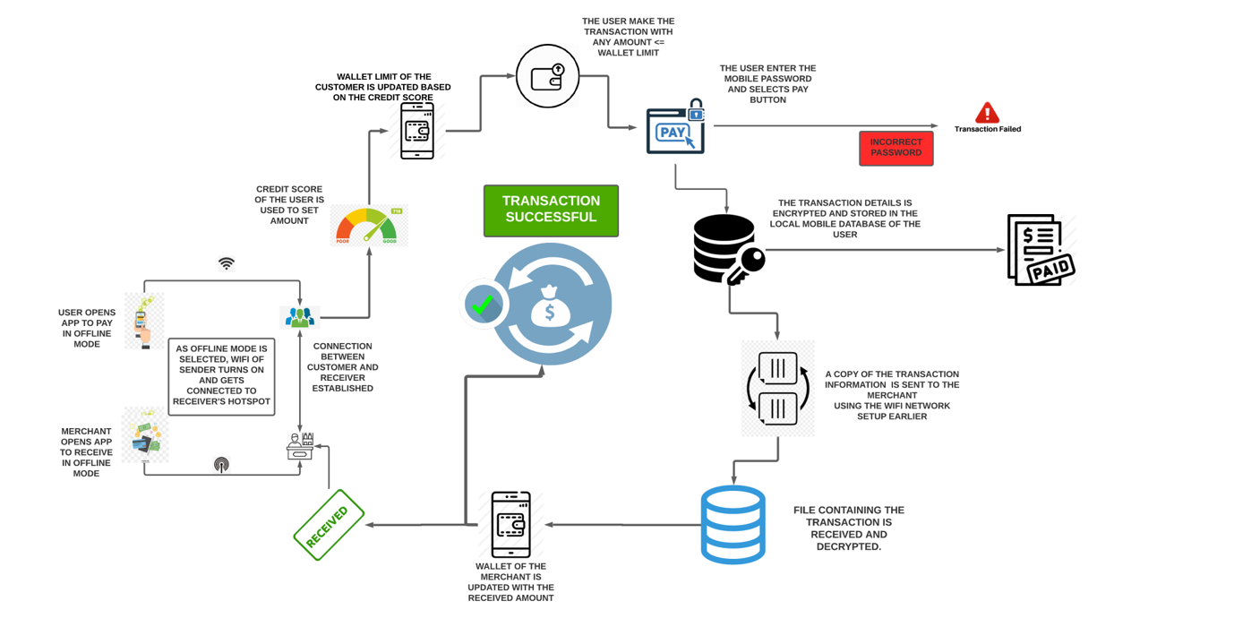

Slide 9
STEP 3
What happens when a user reconnects to the internet ?

Slide 10

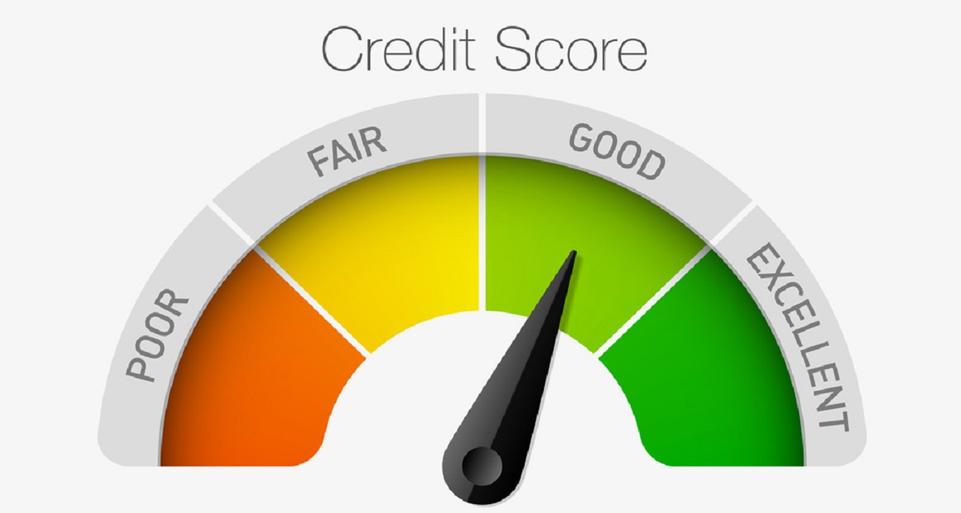
What happen when Internet Connection available??
Buffer
Data moves to
PhonePe server
Buffer clears
Credit Score updated
&
Credit limit Recalculated

Slide 11
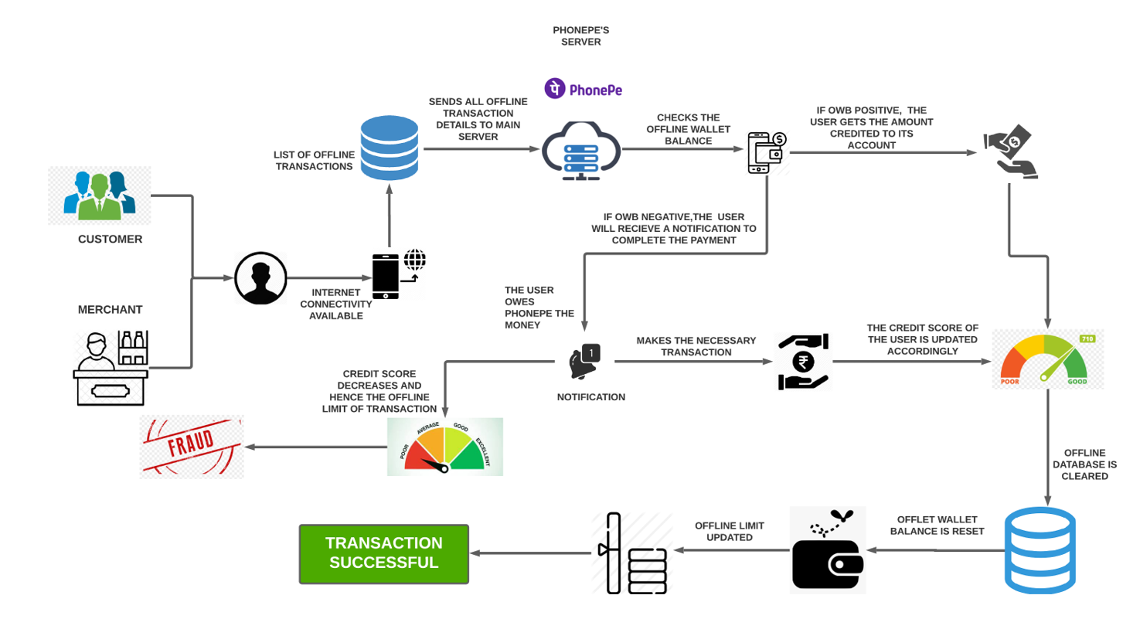


Slide 12

How will the Transactions be stored in Mobile?
We will use cryptography to ensure the security of the data stored in the mobile phone.
We can use any encryption and decryption scheme to achieve this level of security.
We would demonstrate the same with Advanced Encryption Standard (AES). For more security we can use RSA and Elliptic curve Cryptography.

Slide 13
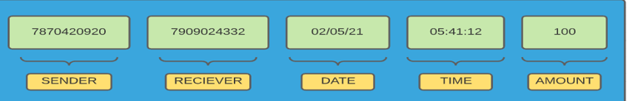
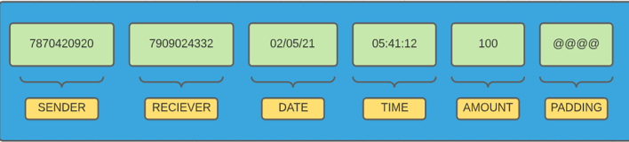
A normal transaction will look like following
For AES to work the length should be multiple of 16 so padding is done for rest of the remaining length with a dummy character (here it is @). This gives us the following text

Slide 14
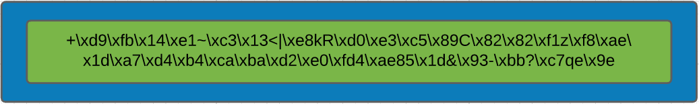
Using Key = "This is a key789" we get a 128 bit AES scheme which upon encryption give following as output
We can see that it is very scrambled and tough for humans to intercept.

Slide 15
How is our idea different?
Out of the ideas that already exist for offline payments in the country, none works for the case when there exist no network in the customer or merchant's end.
This is where our idea stands out where we establish a local connection between the customer and the merchant using wi-fi hotspot pair and use this local connection to help complete the transaction in offline mode and later update it with the server when and as the connection is established at later point of time.
Using the method of credit score for offline payment by limiting the max payment by some function of the credit score we can reduce fraudulent activity and non- payment of the dues from user end as maximum as possible.
We added multiple security to the transaction first by rechecking the phone's pin and using cryptography to secure the information from being retrieved.

Slide 16
How to handle malpractices??
If upon connecting to the internet after completion of a transaction in offline mode, user does not have a sufficient account balance then their credit score will be decreased.
They will not be able to send large amount of money however no problem will be encountered in receiving money.

Slide 17
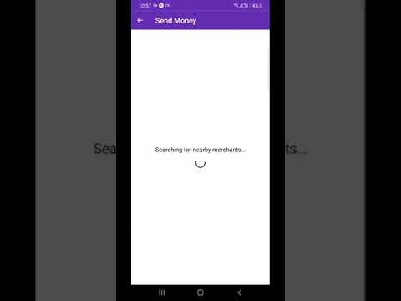
Sender's End

Slide 18
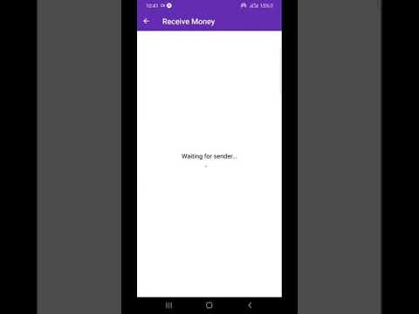
Receiver's End

Slide 19

Thank You
TEAM- CHITTI_LOKHA

